Slide 1

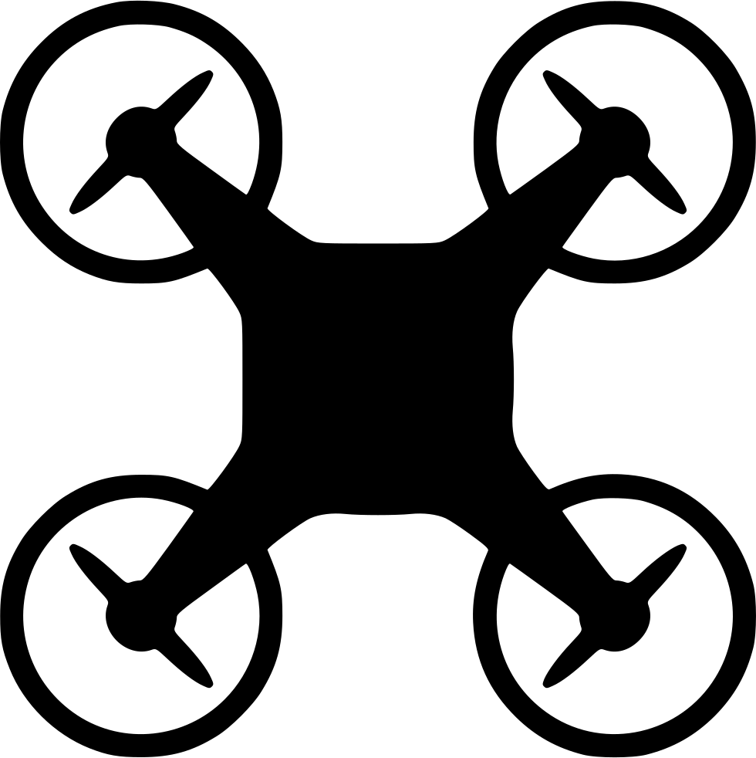

ROS + Gazebo Quadcopter Simulator

Slide 2
What is ROS?
ROS is an open-source robot operating system
A set of software libraries and tools that help you build robot applications that work across a wide variety of robotic platforms
ROS topics are named communication buses that exchange messages between ros nodes and have anonymous publish/subscribe semantics
Several robotics sensors that are supported by official ROS packages
algorithms
sensors
topics
controllers

Slide 3
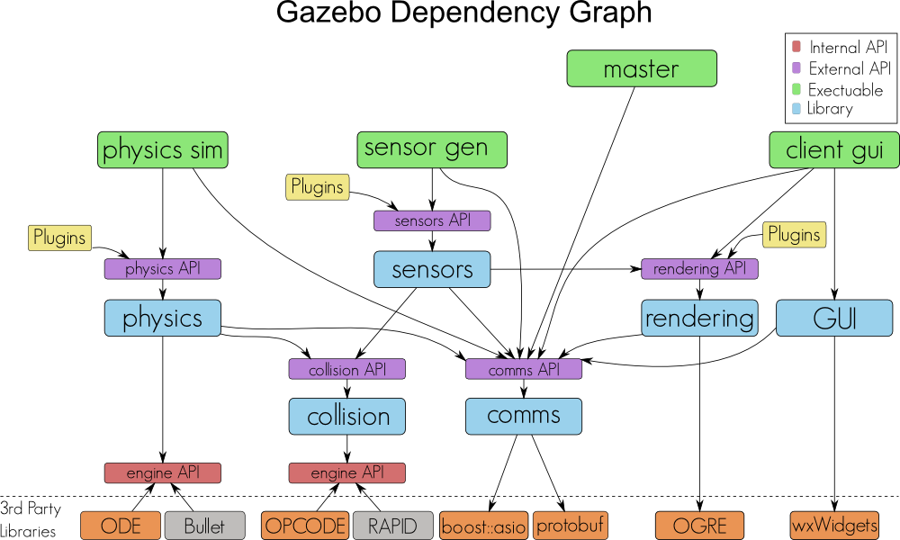
What is Gazebo?
A simulator for robot research
Real time physic engine
High-quality graphics (ORGE)
A rich set of Sensor & Plugins

Slide 4
Simulated Drone Framework (ROS-GAZEBO)
lib_plugin_ros_init.so
/drone/cmd_val
/drone/land /drone/posctrl /drone/reset /drone/takeoff
Gazebo
lib_plugin_drone.so
/drone/imu
lib_plugin_ros_imu.so
lib_plugin_ros_cam.so
/image_raw
Gazebo Environment
ROS-Gazebo Integration
ROS Environment

Slide 5
Contd...!
lib_plugin_ros_init.so
A system plugin for gazebo server
lib_plugin_ros_drone.so
Receives commands from 'drone_keyboard’ through ROS topics
A simple pid controller for inner-loop
A simple position controller
lib_plugin_ros_imu.so
It’s sensor plugin, Publishes the imu(Inertial Measurement Unit) data to ROS.
lib_plugin_ros_cam.so
It’s sensor plugin, Publish the image data to ROS topics

Slide 6
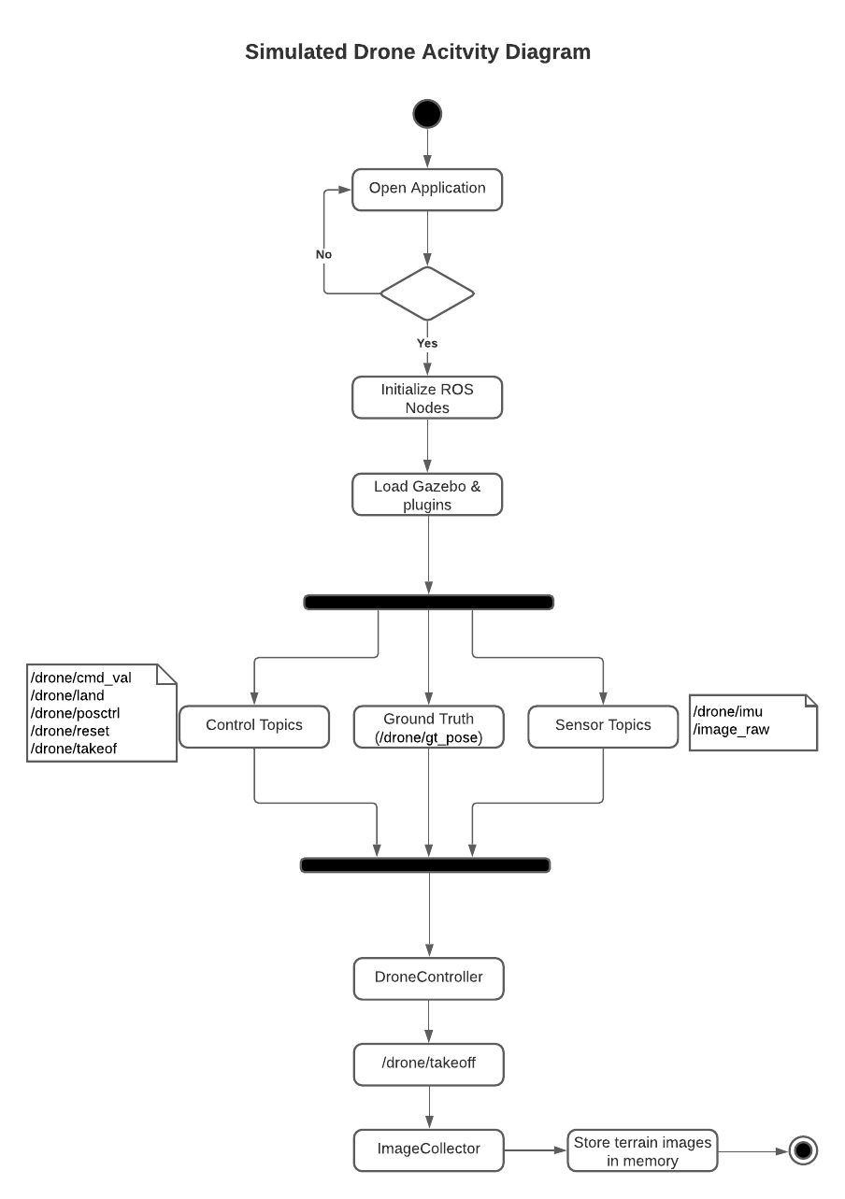
Simulated Drone Activity Diagram

Slide 7
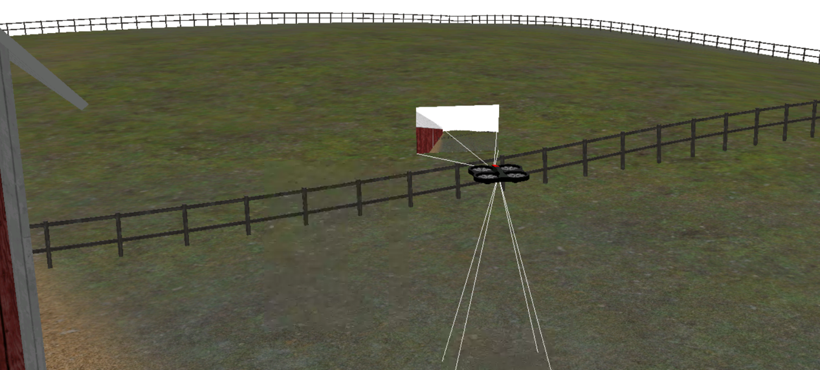
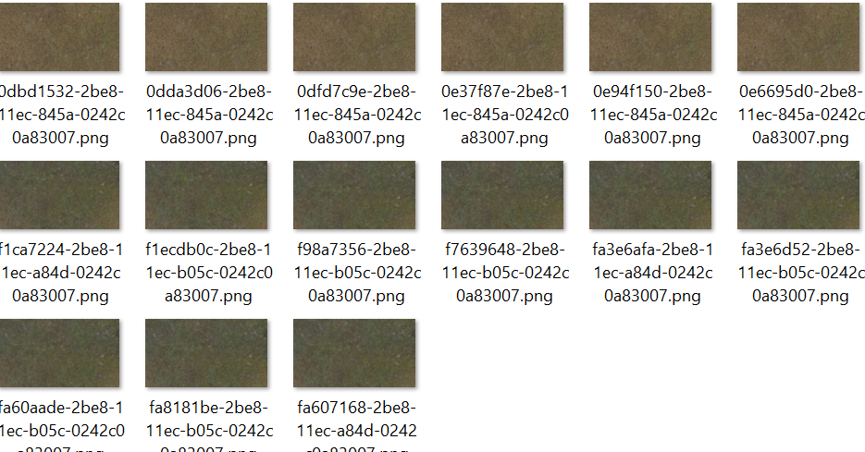
Results: Sample Screenshots
Simulated drone flying in Agriculture terrain
Drone down camera captured Agriculture terrain imges

Slide 8
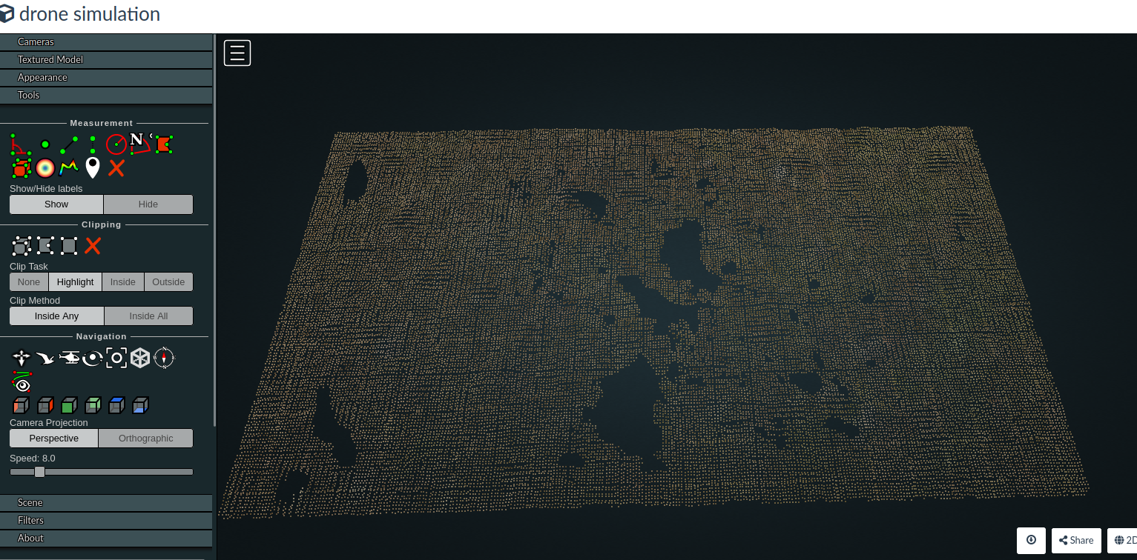
Terrain Orthomosaic Map
The collected terrain Images parsed with ODM software to generate terrain Point cloud, 2D, 3D Orthophotos, Reporting.
Web ODM is the processing engine, whicsh can be used from the command line. It takes images as input and produces a variety of outputs, including point clouds, 3D models and orthophotos

